Slide 1
Big Data, Internet of Things and Artificial Intelligence;
Survival Kits For The Oil And Gas Industry In The Fourth Industrial Revolution.
­­
ABEGUNDE ADEBOWALE NATHANIEL
DEPARTMENT OF GEOLOGY
UNIVERSITY OF IBADAN

Slide 2
PRESENTATION OUTLINE
Introducing the basic concept of Artificial Intelligence (AI)
Internet of Things (IoT)
Big Data
Applications of the BIG 3 in other fields
Applications of the BIG 3 in Oil and Gas
Prediction of Brent Crude Oil Prices using Machine Learning

Slide 3
IoT
THE FOURTH INDUSTRIAL REVOLUTION
DL
BIG DATA
AI
ROBOTICS
ML
CLOUD
AR/VR

Slide 4

INTRODUCING THE BASIC CONCEPT OF ARTIFICIAL INTELLIGENCE
Artificial intelligence (AI), sometimes called machine intelligence, is intelligence demonstrated by machines, in contrast to the natural intelligence displayed by humans. (Wikipedia)

Slide 5



INTRODUCING THE BASIC CONCEPT OF ARTIFICIAL INTELLIGENCE
DL
AI
ROBOTICS
DATA
PREDICT
RESULT
ML
Model Trains on relevant Structured data
Makes it prediction with up to 99.99% accuracy
Gives close to accurate results.

Slide 6

INTERNET OF THINGS(IoT)
The Internet of Things (IoT) is a system of interrelated computing devices, mechanical and digital machines, objects, animals or people that are provided with unique identifiers (UIDs) and the ability to transfer data over a network without requiring human-to-human or human-to-computer interaction.
Internet of Things (IoT) opens room for connectivity among devices, machines and other tools to communicate with each other.

Slide 7
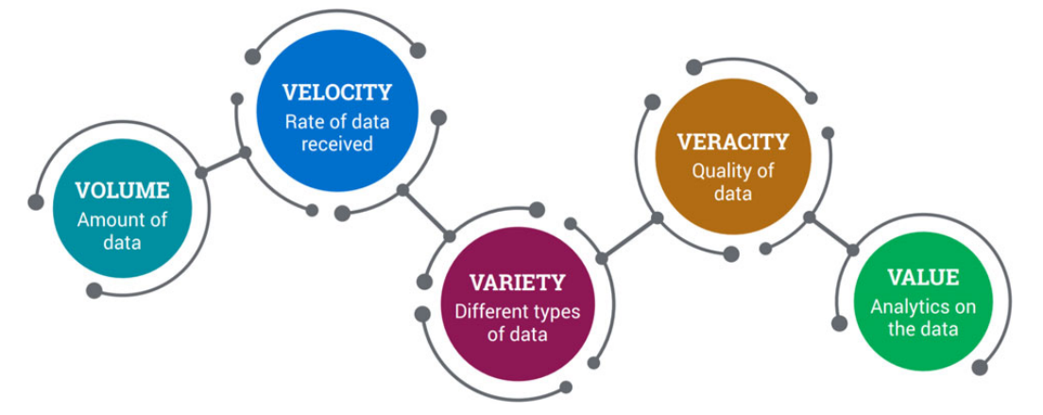
BIG DATA
BIG Data is a field that treats ways to analyze, systematically extract from or deal with datasets that are too large to be dealt with by a traditional data-processing application software.
Big data challenges includes capturing data, data storage, data analysis, data visualization and data transfer.

Slide 8
APPLICATIONS OF THE BIG 3 IN THE OIL AND GAS INDUSTRY
IoT
This can help Oil and Gas companies in data collection of various parameters via sensors such as pressure and temperature of the well amongst other parameters in intervals of seconds or minutes
Formation testing fluid sampling
Crude logistics and trading optimization
Synthetic well logs
Rod pump optimization
Reservoir management
Distributed acoustic and temperature measurements interpretation
Create better solutions faster
Lower development and completion costs
Optimize oil recovery
Reduce well intervention and maintenance costs
Improve safety and environmental performance
Optimize energy generation and consumption.
Siesmic Data Interpretation

Slide 9
Highlighted Problems In The Business Segments Of The Upstream Oil And Gas Operations (Intel IoT Solutions For Upstream Oil And Gas)
EXPLORATION
Siesmic acquisition
Data processing
Interpretation
DRILLING
Real-time monitoring
Predictive maintenance
Completion
PRODUCTION
Real-time monitoring
Reservoir simulation
Recovery optimization
OTHER PROBLEMS
Asset management
Safety and Compliance
Logistics

Slide 10
CASE STUDIES
SHELL NIGERIA
SOFTWEB SOLUTIONS TEXAS

Slide 11
APPLICATIONS OF THE BIG 3 IN THE OIL AND GAS INDUSTRY
BIG DATA
The use of the word Big Data have been used in recent times to quantify huge volumes of data. This description is however incomplete without putting into consideration the 5V’S associated with it.

Slide 12
FACTS
In the Oil and Gas industry, millions of data is generated daily with an estimation of over 1.2 terabytes generated.
Processing these large volumes is not new to the industry however, geophysicist, geologists and reservoir engineers have been using parallel processing capabilities of High-Performance Computing (HPC) to crunch petabytes of data since the late 90’s

Slide 13
What Can Big Data Analysis Do For Oil And Gas Companies?
Using data generated from wells such as the production history can help achieve better production rate and enhanced oil recovery efficiency
Pattern recognition during big data analysis can help save lives and millions of dollars equipment as early detection of anomalies in machines used during drilling can help put an end to such an exploration before a blow-out occurs
Big data analytics with pattern recognition can help in identifying seismic traces which have previously gone unnoticed.
The success of drilling operations could also be predicted after working on data collected from soil and equipment data and weather.

Slide 14
FINALLY
Big data is the engine of the fourth industrial revolution as Artificial intelligence won’t be able to survive without any data to feed on hence a bright future for the oil and gas industry which tends to generate a lot of that. As it stands, big data is the new oil even in the Oil and Gas industry.

Slide 15
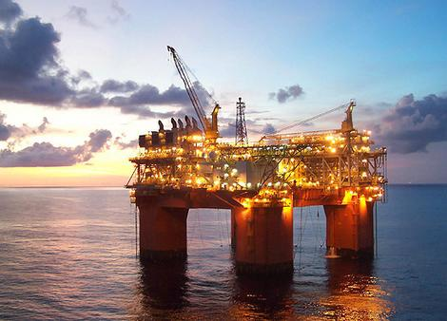
APPLICATIONS OF THE BIG 3 IN THE OIL AND GAS INDUSTRY
ARTIFICIAL INTELLIGENCE
UPSTREAM
AI
MIDSTREAM
DOWNSTREAM

Slide 16
OPERATION APPLICATIONS OF AI
UPSTREAM
Geological Surveys
Exploratory Drilling
Appraisal
Production
Reservoir analysis
Seismic data processing
3-D seismic imagery
Well planning
Automation of drilling rigs
Monitoring of drilling
Real-time drilling optimisation
Well testing using intelligent sensors
Prediction of failure of equipment
Management of geological and geophysical data
Well log digitising
Well log interpretation
Calculation of appraisal drilling parameters
Reservoir modeling
Reservoir characterisation
Optimisation of production throughout its various stages
Flow measurement in wellheads
Automated production control
Reservoir pressure maintenance
Enhancing recovery
Operational troubleshooting
Safety control
Forecasting behavior of a layer depending on its current state

Slide 17
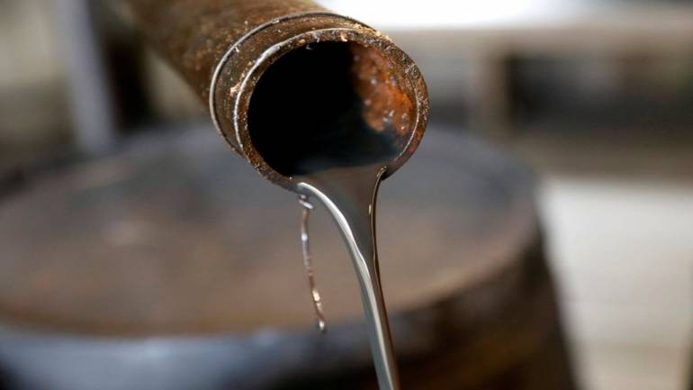
OPERATION APPLICATIONS OF AI
MIDSTREAM
AI for Pipeline Construction
AI for Pipeline Maintenance
Determining the optimal path for pipeline construction
Determining locations of terminals and pipeline connections
Compressor station automation
Early warning about malfunctions
Corrosion monitoring and diagnostics
AI
AI in Sea Transportation
AI for resource allocation
Calculating the most cost effective route
Autopilot and autodocking systems
Tanker monitoring
Analysing economic conditions and weather patterns toforecast demand
Storage optimisation

Slide 18

OPERATION APPLICATIONS OF AI
DOWNSTREAM
PETROCHEMICAL REFINING
STORAGE MANAGEMENT
SECURITY AND ENVIRONMENT
Automation and asset optimisation of refining processes
Use of sensors and microcontrollers for infrastructure maintenance and early warnings
Predictive analytics and predictive control algorithms
Reduced costs of operating storage facilities
Efficient equipment maintenance
Distant monitoring of storage facilities and equipment
Leakage detection
Detection of equipment deformation

Slide 19
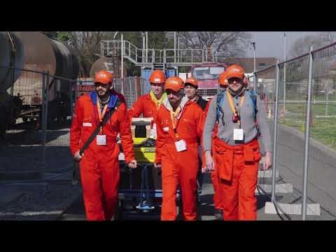
OPERATION APPLICATIONS OF AI
CASE STUDY
Total in 2013 launched the Total’s ARGOS challenge (Autonomous Robot for Gas and Oil sites) which was aimed at building the first autonomous surface robots with the ability to operate on oil and gas sites.

Slide 20
PREDICTION OF BRENT CRUDE OIL PRICES USING MACHINE LEARNING
Overview
Crude oil is one of the most prominent energy resource in the world. However, the volatility in oil prices in recent times have led to oil and gas companies watching out for optimization. Therefore, the need for crude oil prices forecast cannot be overemphasized.
Methodology and Case Study
The Brent crude oil prices used as a case study in this paper ranged from May 1987 to September 2019. This data was provided by United States Energy Information, and hosted on Kaggle (www.kaggle.com).

Slide 21
PREDICTION OF BRENT CRUDE OIL PRICES USING MACHINE LEARNING
MAIN LIBRARIES
Numpy: Library for multidimensional arrays with high level mathematical functions to operate them.
Pandas: Works on top of Numpy, offer a great way of manipulate and analyse data.
Matblotlib: Plotting and visualization.
Seaborn: Works on top of matplotlib to provide a high level interface for attractive plotting and visualization.
Scikit Learn: Libraries for Machine Learning. In this exercise we will use the following: Linear Regression, Random Forest Regression and K-means

Slide 22
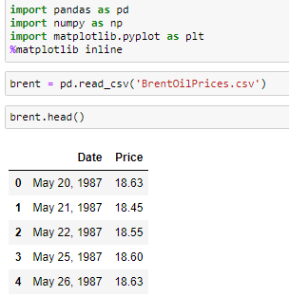
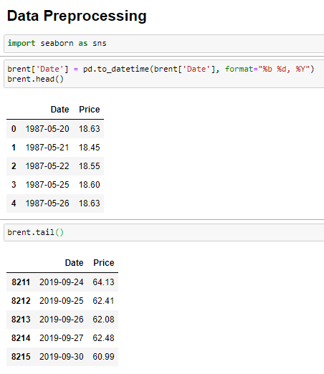
PREDICTION OF BRENT CRUDE OIL PRICES USING MACHINE LEARNING

Slide 23
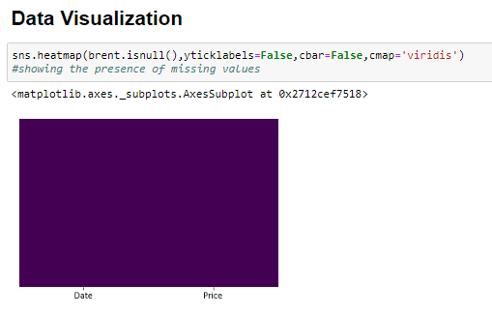
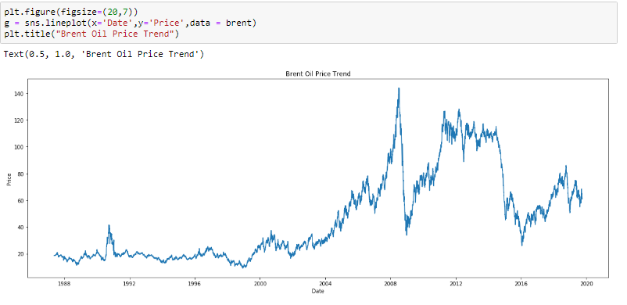
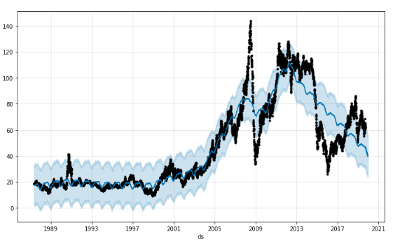
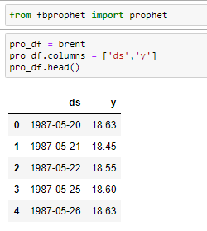
PREDICTION OF BRENT CRUDE OIL PRICES USING MACHINE LEARNING

Slide 24
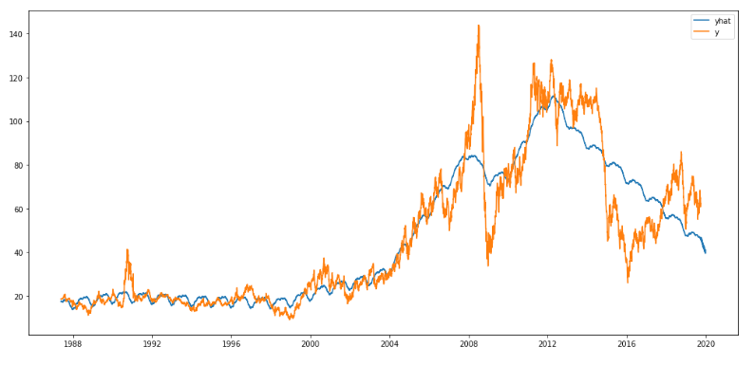
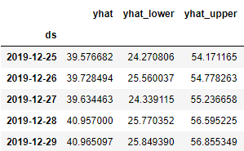
PREDICTION OF BRENT CRUDE OIL PRICES USING MACHINE LEARNING
RESULT AND DISCUSSION
It can be observed there was an abrupt increase in crude oil prices between Mid-2006 to 2009 when it reached its peak, and a vertical drop in the price. From 2016 however, there have been a steady increase and a slight fluctuation in 2019. The forecasted values from late 2019 shows a gradual dip up until 2020

Slide 25
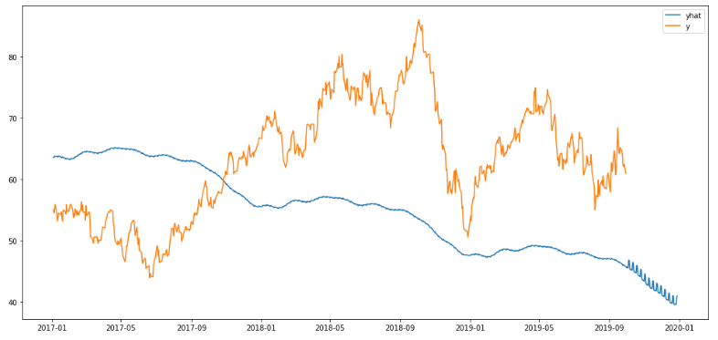
PREDICTION OF BRENT CRUDE OIL PRICES USING MACHINE LEARNING
RESULT AND DISCUSSION
The Figure below shows the forecasted Brent Crude Oil Prices from 01-2017 to 01-2020, predicting a decline in Brent crude Prices from 10-2019 to 01-2020

Slide 26
CONCLUSION
The survival of the Oil and gas industry through the fourth industrial revolution is dependent on how Artificial Intelligence, Big data and Internet of things technologies can be harnessed.
Furthermore, the exploitation of these technologies can see Oil and Gas companies create value that is based on innovation hence leading to a competitive and sustainable advantage.
Although the application of these technologies in the upstream sector have been very appreciative however, the midstream and downstream sector seem not to have gotten a good grasp of its application in their operation. It’s therefore encouraged that more R&D investments should be made in these sectors to provide a cleaner energy for sustainability.

Slide 27

THANK YOU
Nathaniel Adebowale ABEGUNDE
DEPARTMENT OF GEOLOGY, UNIVERSITY OF IBADAN
aabegunde063@stu.ui.edu.ng , aanathaniel@gmail.com
+2348103617151
www.linkedin.com/in/abenath

